Slide 1
Distal femur fracture treatment
S.Azarsina M.D
Alborz university of medical sciences

Slide 2
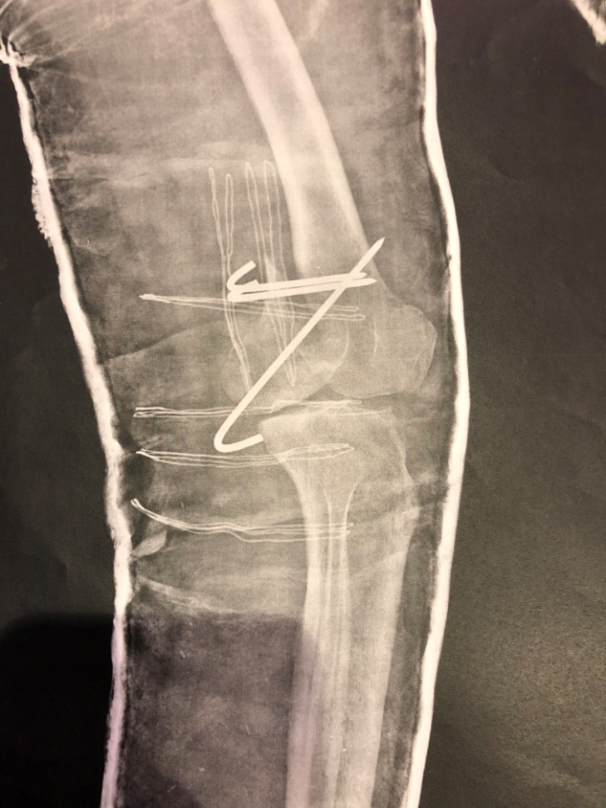
A 50 y/o woman referred to us…

Slide 3


Slide 4

Goal of treatment

Slide 5
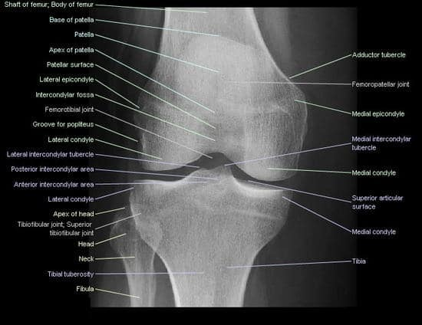
Goal of treatment
Joint anatomic reduction

Slide 6
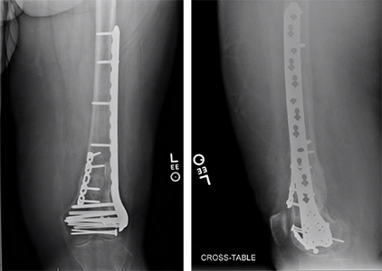
Goal of treatment
Joint anatomic reduction
Stable internal fixation

Slide 7
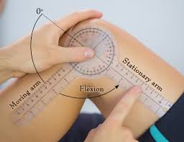
Goal of treatment
Joint anatomic reduction
Stable internal fixation
Early ROM

Slide 8
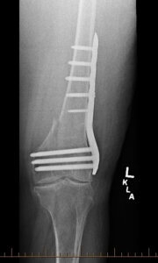
Goal in younger patients
Restoration of length

Slide 9
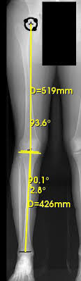
Goal in younger patients
Restoration of length
Axial alignment

Slide 10
Goal in younger patients
Restoration of length
Axial alignment
Stable fixation
Early functional rehabilitation

Slide 11
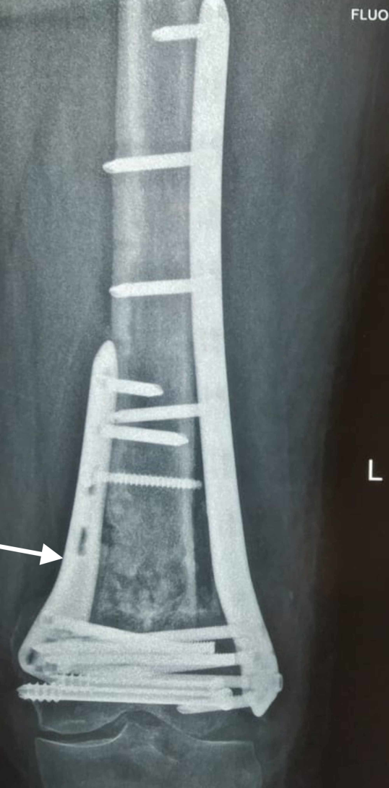
Goal in elderly osteoporotic patient
Impaction of metaphyseal fragments(shortening)
  More rapid union

Slide 12
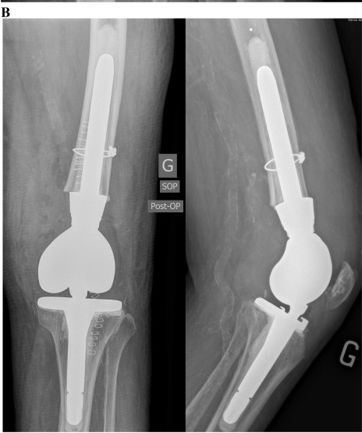
Tumor prosthesis
Highly comminuted fracture
Incompetent bone

Slide 13
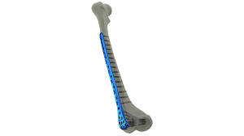
Recommended devices
Locked plating

Slide 14
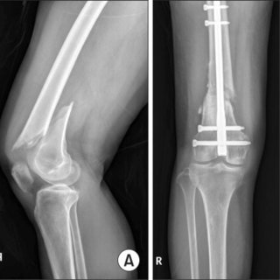
Recommended devices
Locked plating
Closed retrograde intramedullary nailing

Slide 15

Timing of surgery
24-48 hours in isolated fractures

Slide 16
Timing of surgery
24-48 hours in isolated fractures
Tibial pin traction or external fixator if surgery is delayed more than 36 hours

Slide 17
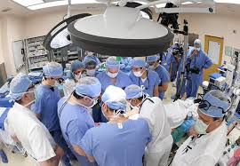
Surgical decision making
Age

Slide 18
Surgical decision making
Age
Ambulatory status

Slide 19
Surgical decision making
Age
Ambulatory status
Osteoporosis

Slide 20
Surgical decision making
Age
Ambulatory status
Osteoporosis
Comminution

Slide 21
Surgical decision making
Age
Ambulatory status
Osteoporosis
Comminution
Soft tissue

Slide 22
Surgical decision making
Age
Ambulatory status
Osteoporosis
Comminution
Soft tissue
Open wound

Slide 23
Surgical decision making
Age
Ambulatory status
Osteoporosis
Comminution
Soft tissue
Open wound
Joint involvement

Slide 24
Surgical decision making
Age
Ambulatory status
Osteoporosis
Comminution
Soft tissue
Open wound
Joint involvement
Isolated or multiple fx

Slide 25
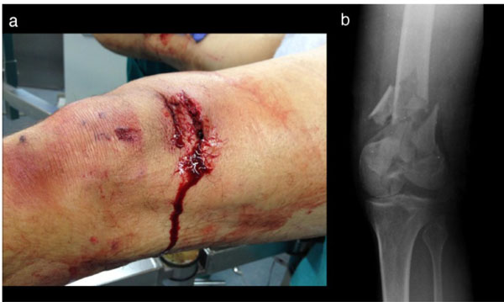
Open fractures
Type 1-3A
  Immidiate or early internal fixation

Slide 26
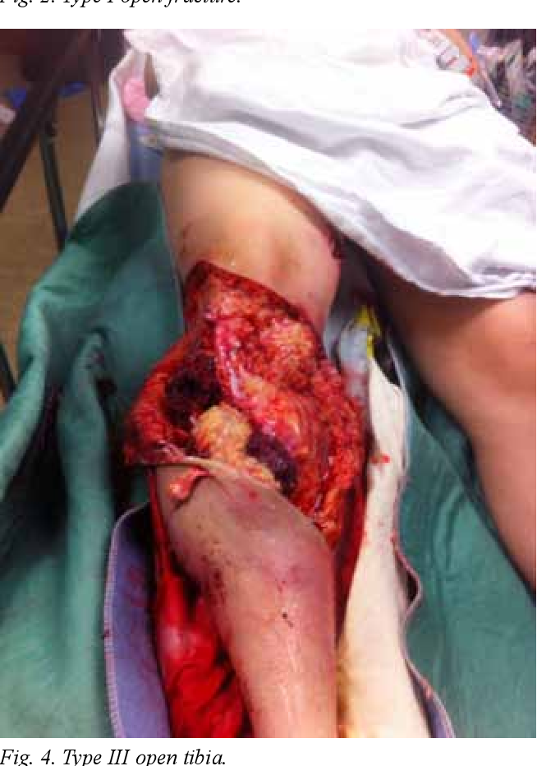
Open fractures
Type 3B,3C
  external fixation with delayed internal fixation

Slide 27
Open fractures
Type 3B,3C
  external fixation with delayed internal fixation
  Debridement every 48 hour

Slide 28
Open fractures
Type 3B,3C
  external fixation with delayed internal fixation
  Debridement every 48 hour
  Wound VAC or antibiotic beads are useful

Slide 29
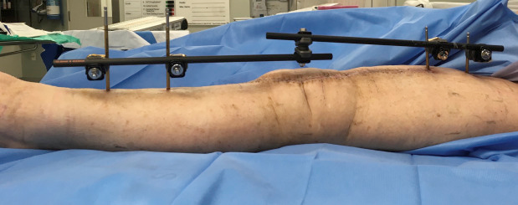
External fixator
  2 anterior pins in proximal tibia
  2 anterior or lateral pins in the mid,proximal femur(proximal to plate)

Slide 30
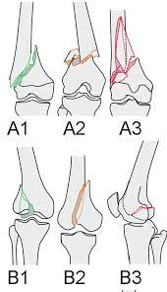
OTA type A

Slide 31
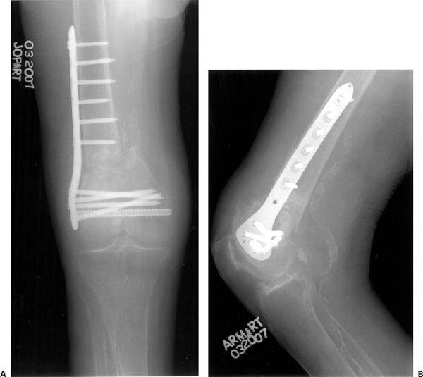
OTA type A
Open locked plating with lateral approach

Slide 32
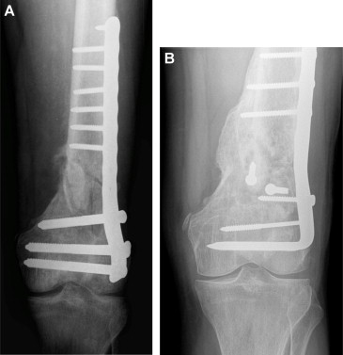
OTA type A
Open locked plating with lateral approach
  95 angle blade

Slide 33
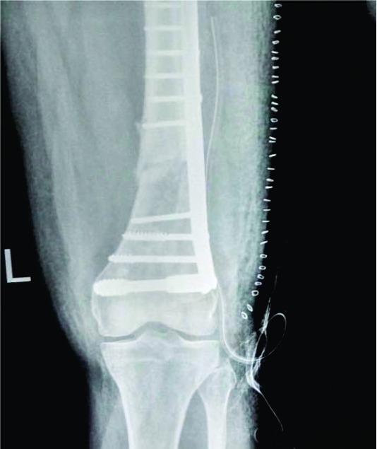
OTA type A
Open locked plating with lateral approach
  95 angle blade
  DCS

Slide 34
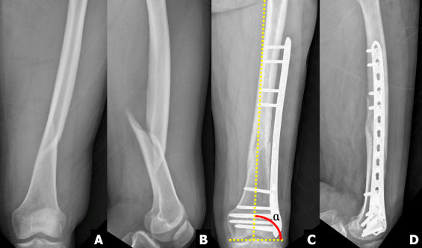
OTA type A
Open locked plating with lateral approach
  95 angle blade
  DCS
Minimally invasive locked plating

Slide 35
OTA type A
Open locked plating with lateral approach
  95 angle blade
  DCS
Minimally invasive locked plating
Locked retrograde nailing

Slide 36
OTA type B

Slide 37
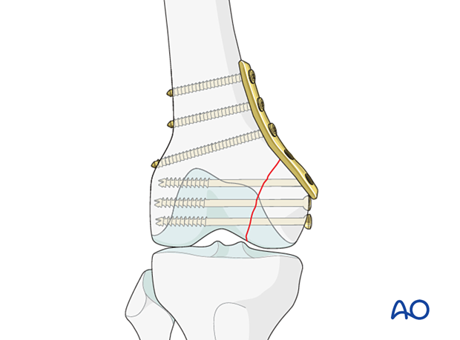
OTA type B
Buttress plating

Slide 38
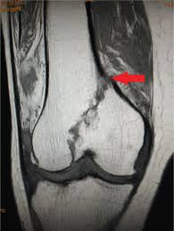
OTA type B
Buttress plating
  Lag screw alone for undisplaced cases

Slide 39
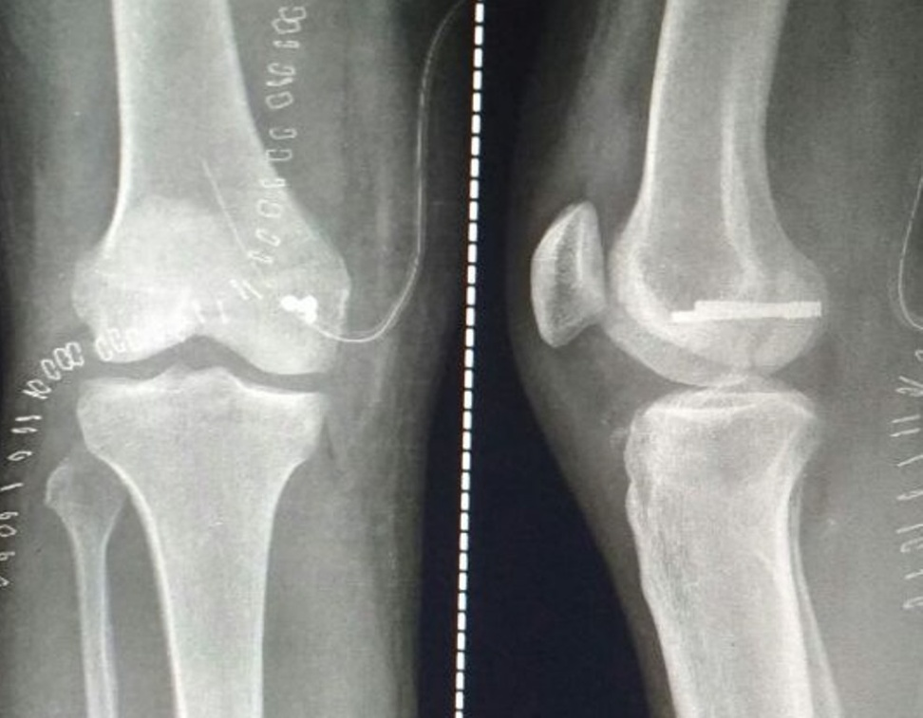
OTA type B
Buttress plating
  Lag screw alone for undisplaced cases
Countersunk screws for hoffa fx

Slide 40
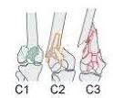
OTA type C

Slide 41
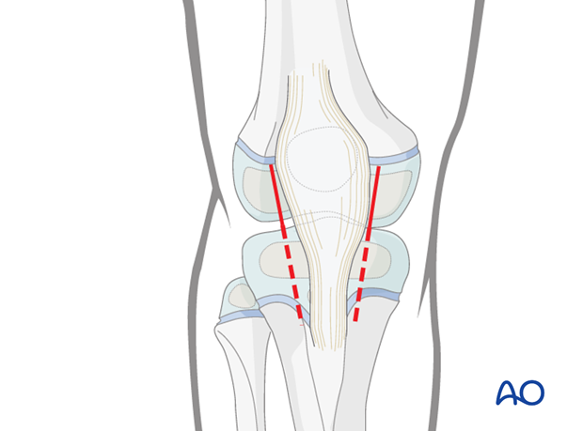
OTA type C
Parapatellar arthrotomy for ORIF of articular fracture
  3.5,4.5 screws

Slide 42
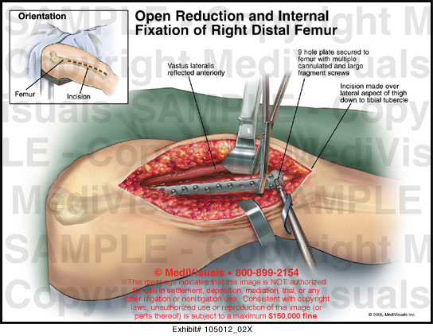
OTA type C
Parapatellar arthrotomy for ORIF of articular fracture followed by
  Open locked plating

Slide 43
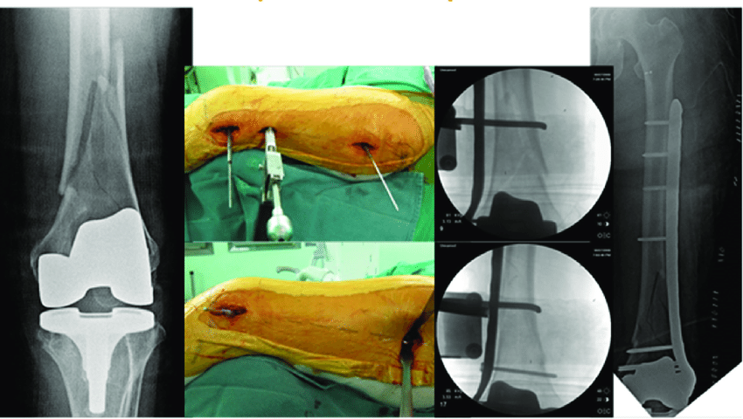
OTA type C
Parapatellar arthrotomy for ORIF of articular fracture followed by
  Open locked plating
  Minimally invasive locked plating

Slide 44
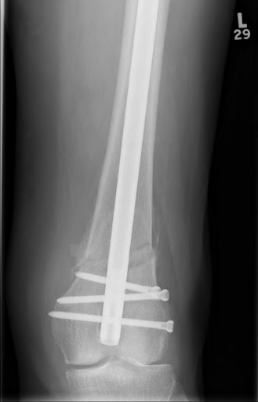
OTA type C
Parapatellar arthrotomy for ORIF of articular fracture followed by
  Open locked plating
  Minimally invasive locked plating
  Locked retrograde nailing

Slide 45
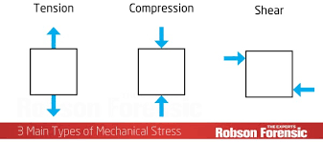
Fracture biomechanics

Slide 46
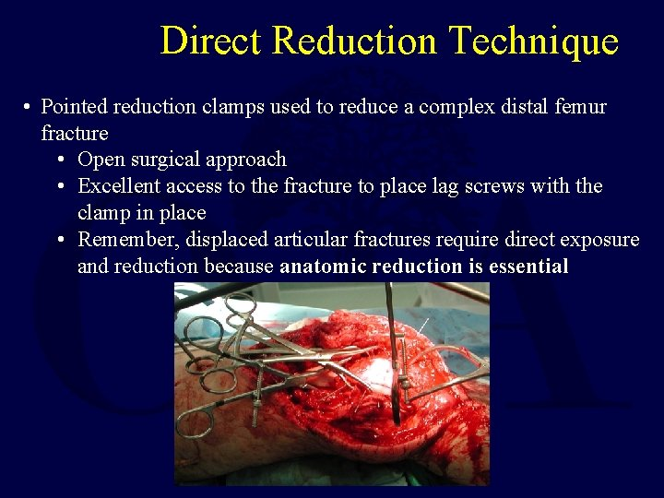
Fracture biomechanics
Direct reduction

Slide 47
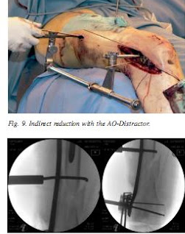
Fracture biomechanics
Direct reduction
Indirect reduction (bridge plating)

Slide 48
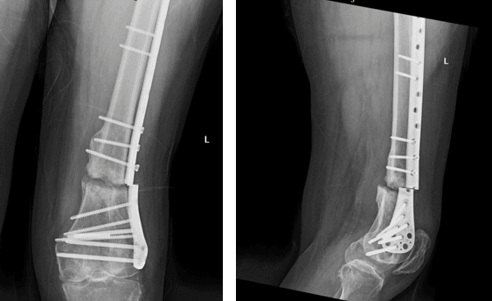
Fracture biomechanics
Direct reduction
  Fracture site gapping causes nonunion and device failure

Slide 49
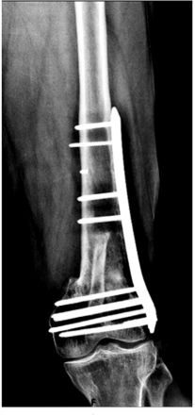
Fracture biomechanics
Direct reduction
  Fracture site gapping causes nonunion and device failure
  Eight cortices of fixation above and below fracture site

Slide 50
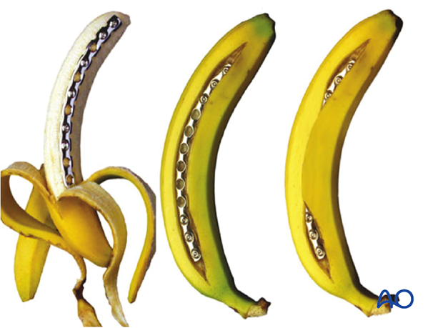
Fracture biomechanics
Indirect reduction(bridge plating)

Slide 51
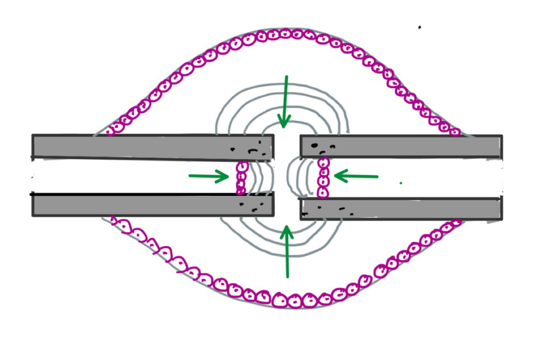
Fracture biomechanics
Indirect reduction
  A stiff construct causes failure (impairs secondary bone healing)

Slide 52
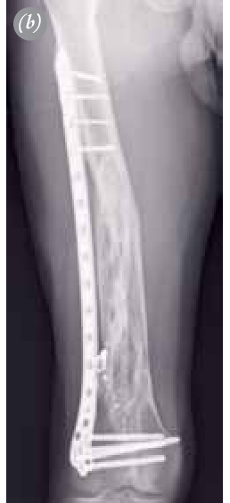
Fracture biomechanics
Indirect reduction
  Use longer plates with well spaced cortical screws

Slide 53
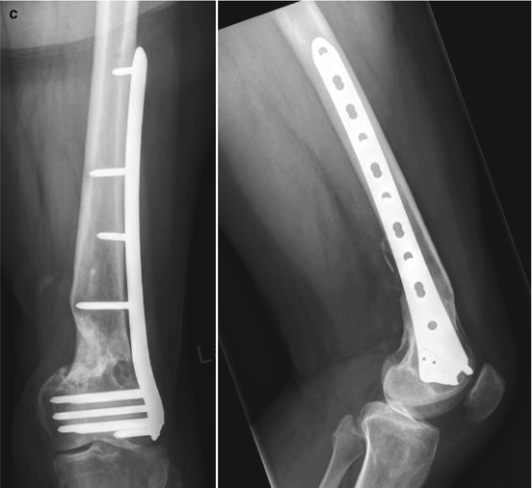
Fracture biomechanics
Indirect reduction
  No more than 50% of screw holes filled
    Prevents stress concentration and implant breakage

Slide 54
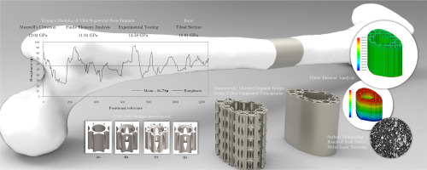
New methods to control implant stiffness

Slide 55
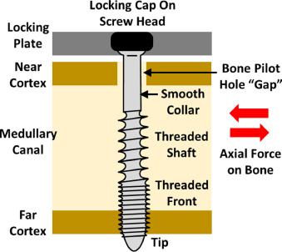
New methods to control implant stiffness
FCL
  Far cortical locking

Slide 56
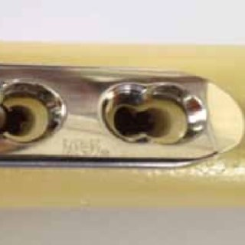
New methods to control implant stiffness
FCL
Slotting of near-cortical holes

Slide 57
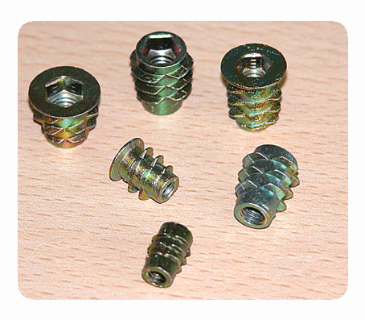
New methods to control implant stiffness
FCL
Slotting of near-cortical holes
Threaded screw head inserts

Slide 58

Why???

